Slide 1
IMC: Outbound Digital Marketing

Slide 2
Overview
Digital branding
Outbound marketing
  Email
  Search advertising
  Display advertising
Pros and Cons

Slide 3
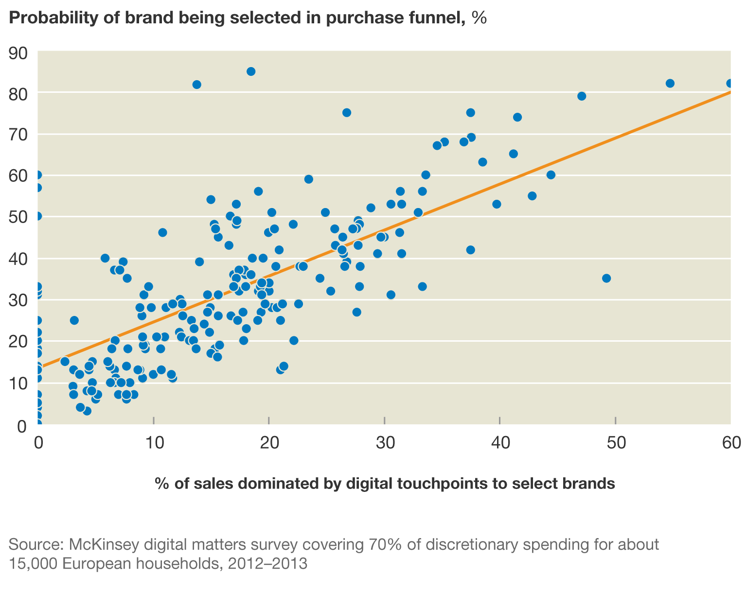
Impact of Digital Branding

Slide 4
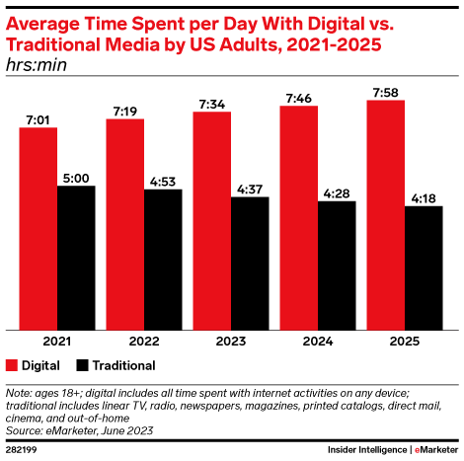
Where are the eyeballs?

Slide 5
Digital Advertising
Email
Search
Display

Slide 6
Email Marketing
Still a force—average ~3% response rate
Customers’ preferred medium for a relevant offer
Must be “permission”, not spam
Use of visuals and animations to increase appeal
Use database to personalize
A/B testing to refine
SMS plays a similar and growing role

Slide 7
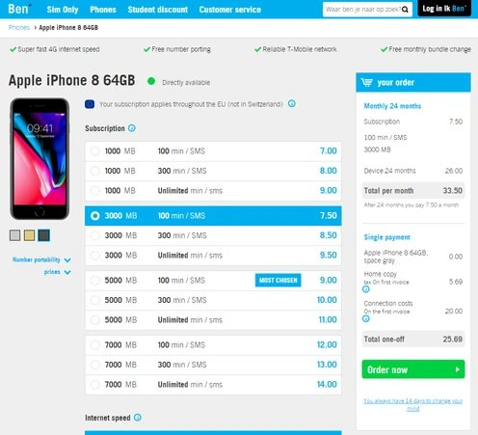
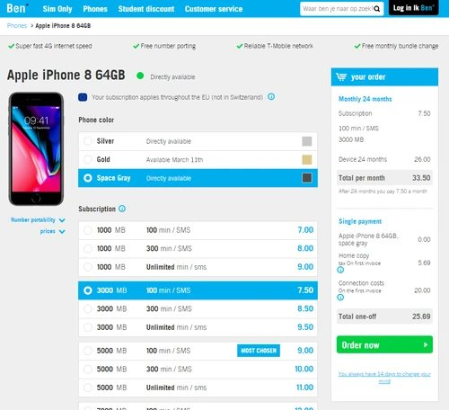
A/B Test Example—17.6% lift
2.2% conversion rate
2.6% conversion rate

Slide 8
Search Advertising
Dominated by Google
Ad position dictated by:
  Auction
  Relevance
Dynamic “real-time” bidding model

Slide 9
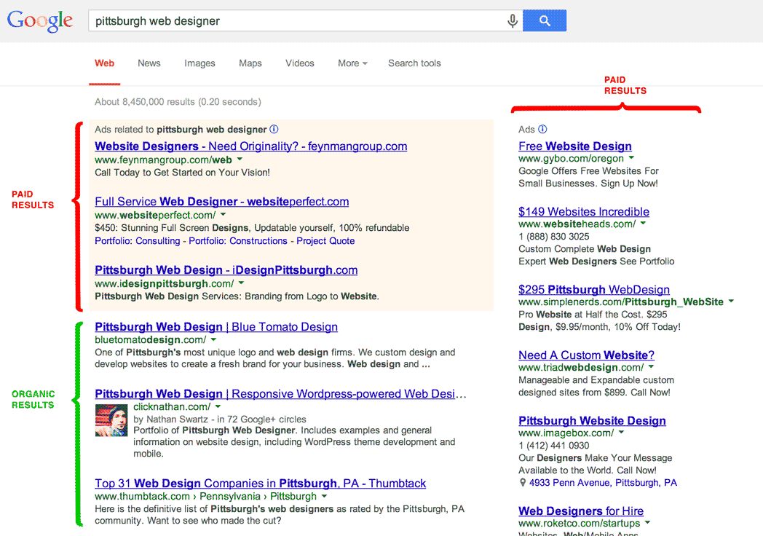
Search Ads

Slide 10
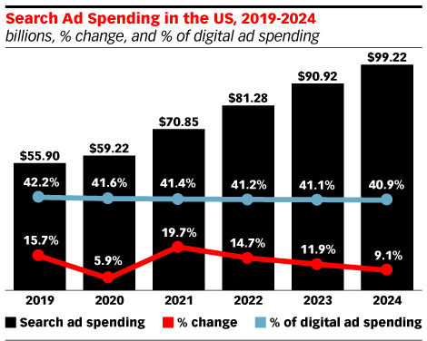
Trend in Expenditures

Slide 11
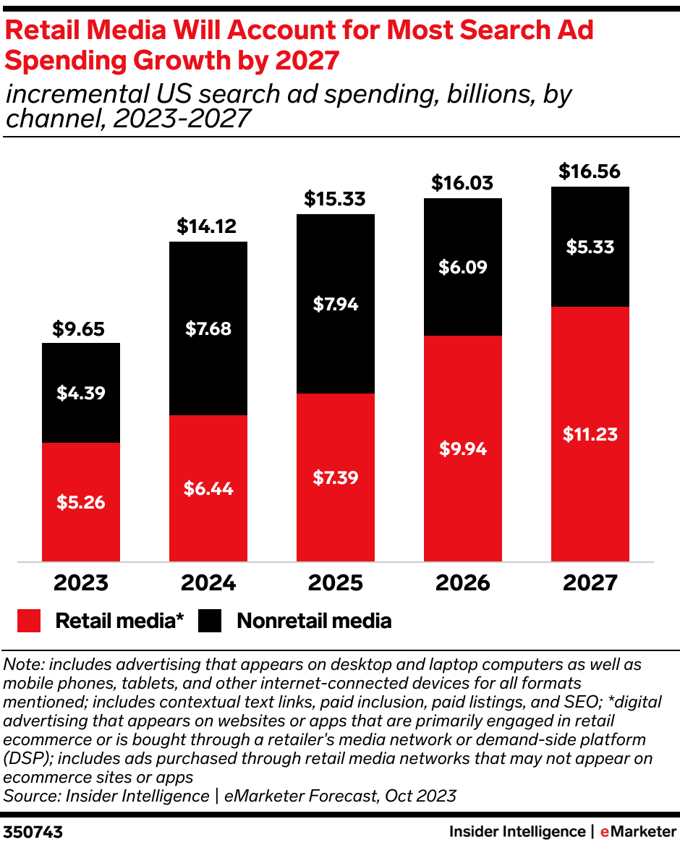
Retail Media Growth 2025-2027

Slide 12
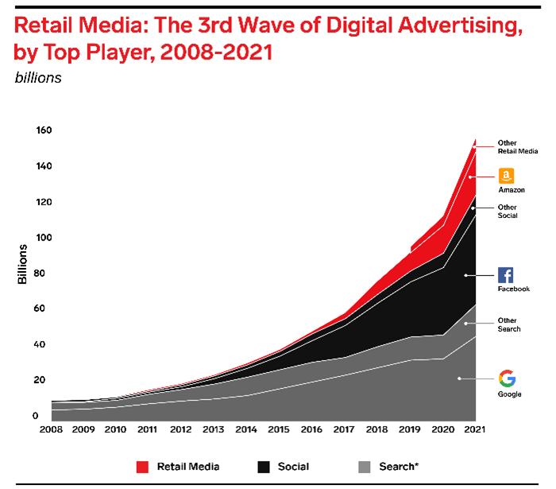
Top Retail Media in Ad Revenues

Slide 13
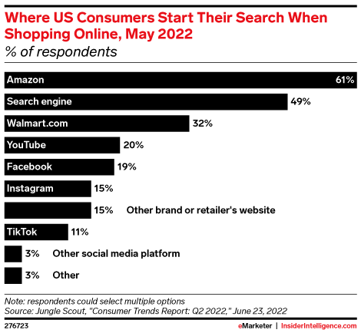
Where Do Consumers Start their Online Shopping?

Slide 14
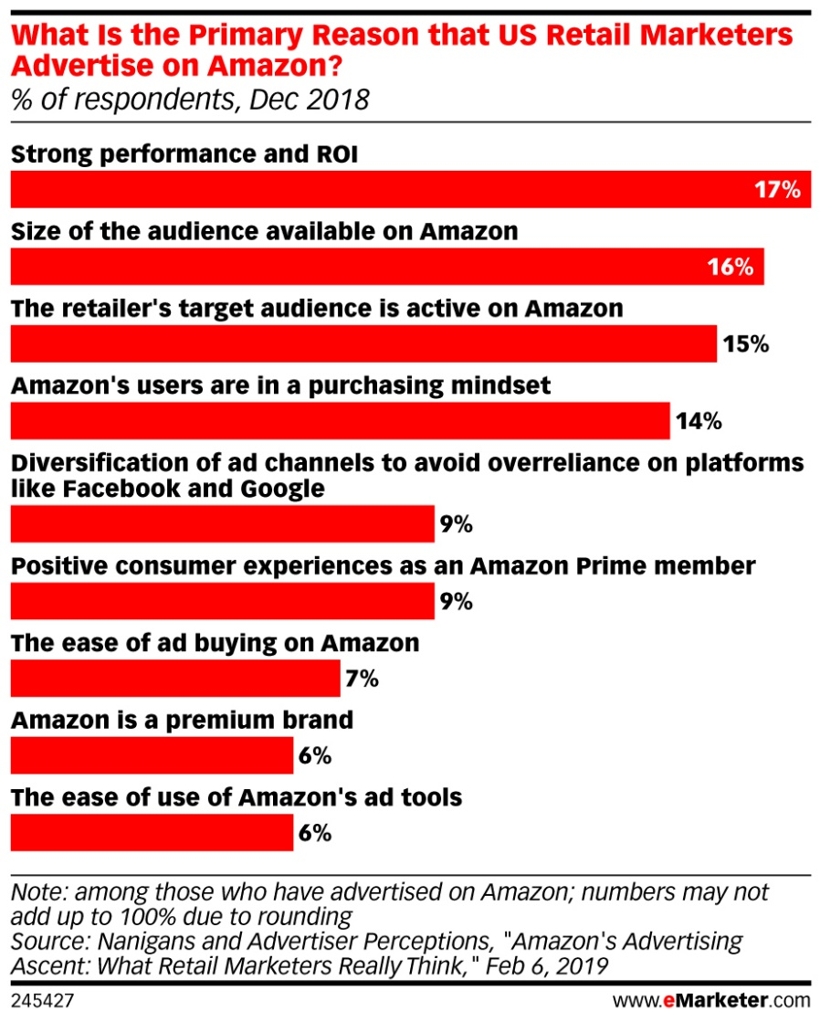
Why Do Marketers Advertise on Amazon?

Slide 15
Most Valuable Metrics
Incremental sales
Return on ad spend
ROI
Sales attribution
Conversion rate

Slide 16
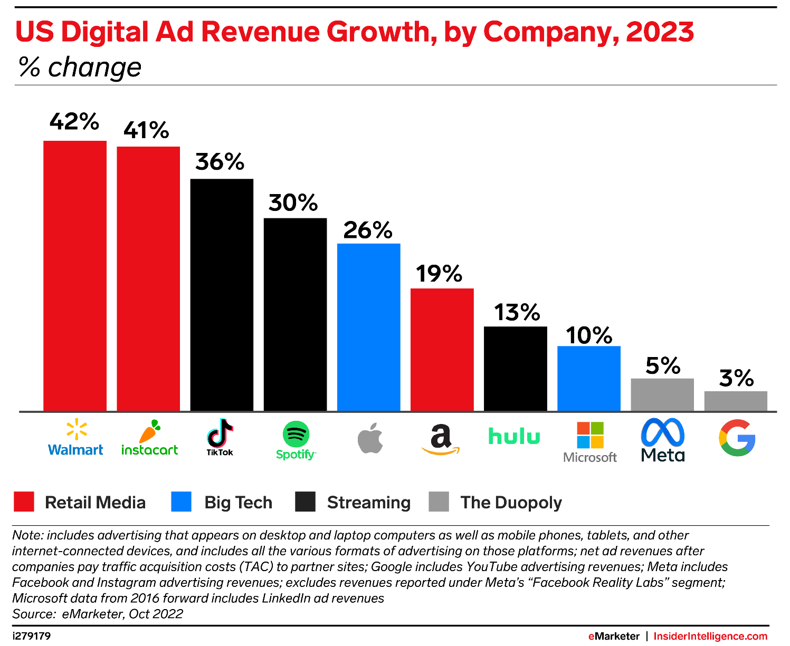
Other Media Growing Rapidly

Slide 17
Display Advertising
Typical banner ads, but…
Includes video ads, which are now in the majority
Sold through 50+ ad networks
Behavioral targeting
  Done through use of cookies
  Increases relevance of ads to user
  Real-time auctions
  Programmatic buying dominant

Slide 18
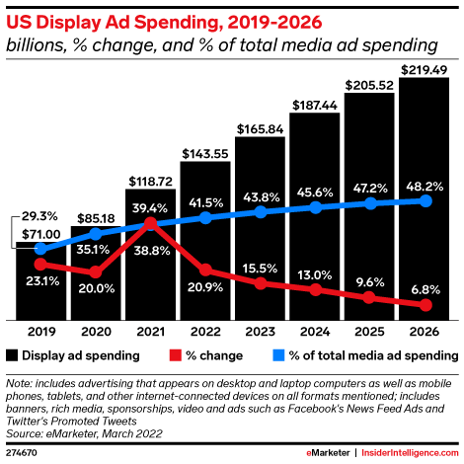
Trend in Display Advertising

Slide 19
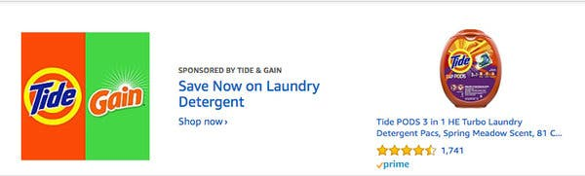
Display Ad Leadership
Google and Facebook dominate
Amazon challenging

Slide 20
Digital Advertising Plus Points
Broad and cost-efficient reach
Precise targeting
Interactive character builds engagement
Cost-effective for new or smaller firms
Adaptability
24/7 accessibility

Slide 21
Digital Advertising Challenges
Click fraud
Constantly changing algorithms
Adblocking software
Consumer multitasking
Brand safety
Privacy concerns

Slide 22
Conclusion
Is your firm fully engaged in outbound digital marketing?
Does your firm use email campaigns?
Does your firm use A/B testing to refine its digital advertising appeals?

Slide 23
End of Lecture

